Slide 1
Pseudo Random binary sequence generator

Slide 2
PRNG
A pseudo Random number generator (PRNG), also known as a deterministic random bit generator (DRBG), is an algorithm for generating a sequence of numbers whose properties approximate the properties of sequences of random numbers.
The PRNG-generated sequence is not truly random, because it is completely determined by an initial value, called the PRNG's seed(which may include truly random values).

Slide 3
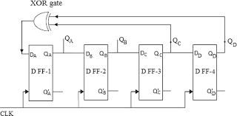
Logic circuit
Let us assume initial value as 0001

Slide 4
Truth table
X | Y | Z=X⊕Y
0 | 0 | 0
0 | 1 | 1
1 | 0 | 1
1 | 1 | 0
Qd | Qc | Qb | Qa
0 | 0 | 0 | 1
0 | 0 | 1 | 0
0 | 1 | 0 | 0
1 | 0 | 0 | 1
0 | 0 | 1 | 1
0 | 1 | 1 | 0
1 | 1 | 0 | 1
Qd | Qc | Qb | Qa
1 | 0 | 1 | 0
0 | 1 | 0 | 1
1 | 0 | 1 | 1
0 | 1 | 1 | 1
1 | 1 | 1 | 1
1 | 1 | 1 | 0
1 | 1 | 0 | 0
1 | 0 | 0 | 0

Slide 5
Applications
PRNGs are central in applications such as simulation (e.g. for the Monte Carlo method),
Electronic games(e.g. for procedural generation)
Cryptography
Testing digital circuits
Digital to analog circuits

